Slide 1
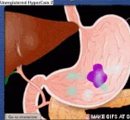
Chemical digestion
AEHBY ATAR Human Biology

Slide 2
Review
What type of molecules are found in the lining of the digestive system (aka alimentary canal/ gastrointestinal tract)?
What stops the digestive enzymes from digesting the digestive system?
What is pepsinogen and how is it activated?
Why are there different enzymes for different substrates and why do they work in different locations?

Slide 3
Learning Intentions
The salivary glands, pancreas, liver and gall bladder produce or store secretions which aid the processes of digestion.

Slide 4
Success Criteria
Identify accessory glands of the digestive system.
For each, describe their function and products (for those that have multiple functions, just those that relate to digestion for now)
Explain why some enzymes are produced outside of the gastrointestinal tract and some are produced at the site of function.

Slide 5

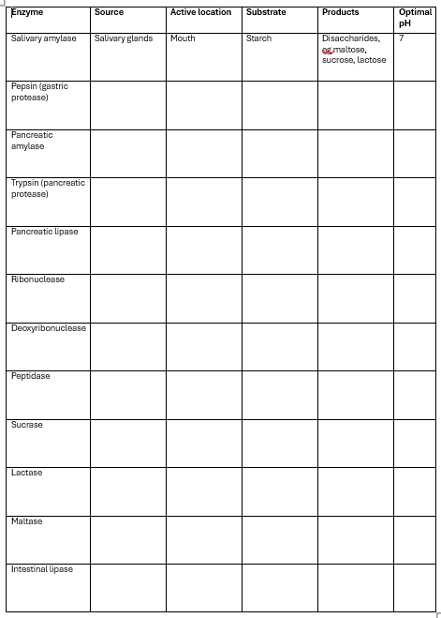

Activity 1

Slide 6
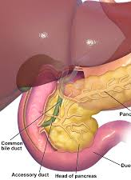
Accessory glands
While some digestive enzymes are produced at the site of function, eg stomach or small intestine, many are produced by accessory glands outside of the gastrointestinal tract and delivered to the site of function by ducts.

Slide 7

Activity 2: Job Advertisement
Qualifications
Roles/responsibilities
Work conditions/environment
Location
Pay?

Slide 8
Success Criteria
Identify accessory glands of the digestive system.
For each, describe their function and products (for those that have multiple functions, just those that relate to digestion for now)
Explain why some enzymes are produced outside of the gastrointestinal tract and some are produced at the site of function.

